Slide 1
Rubin/LSST photo-D: Brief Introduction
Photo-D: estimate distances to stars using LSST photometry
- akin to photo-z in the context of galaxies (redshift and galaxy type)
Method: given T_{eff}, [Fe/H], and log(g), Luminosity follows and thus D
- shown to work well with SDSS and Gaia data (and others)
T_{eff}, [Fe/H], log(g) and dust A_{V} can be constrained using LSST photometry
- need full Bayesian treatment (”if MS then best D is...; if WD then best D is...”)
- not compute intensive per star, but 10 billion stars
- a good code base (chi2 minimizer with model SEDs) exists but too slow: BEAST
- investigating grid search with empirically calibrated isochrones
The methods and implementation must be thoroughly tested
- tests based on simulations and SDSS and Gaia datasets
The products must be made available on RSP in timely fashion and user friendly
- Bura at UniRi, perhaps UW cluster, cloud, elsewhere?

Slide 2
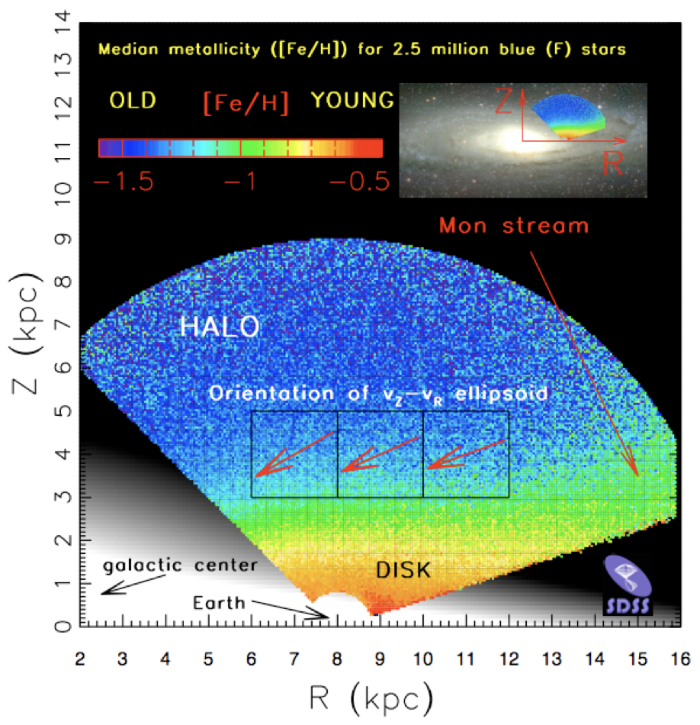
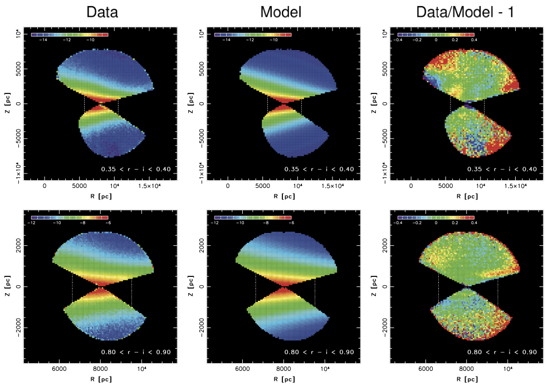
photo-D methodology: science motivation
if we know stellar distances, we can study the Milky Way structure
Ivezic+ (2008, ApJ, 684, 287)
Juric+ (2008, ApJ, 673, 864)

Slide 3
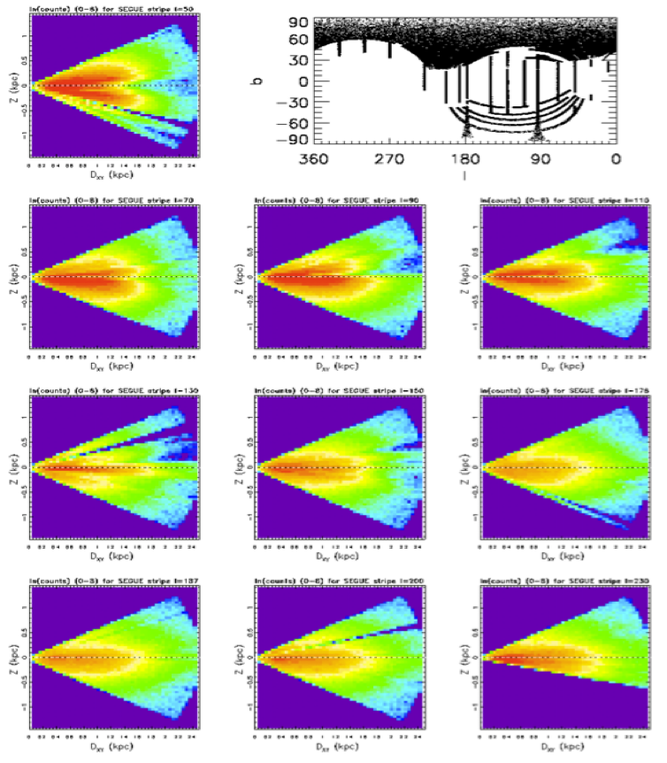
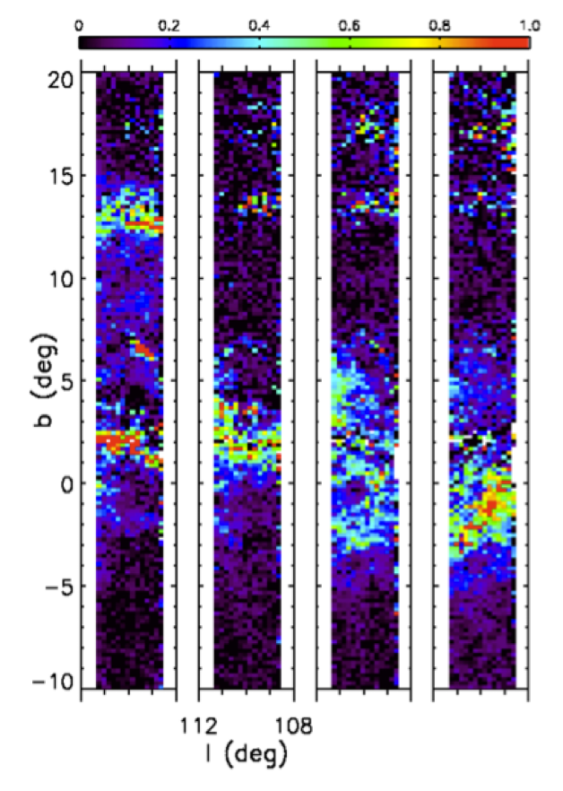
photo-D methodology: science motivation
if we know stellar distances, we can study the Milky Way structure
furthermore, at low galactic latitudes, we can map dust (and its properties), too
left: differences in median A_{r} for D~ 1, 1.5, 2, 2.5 kpc
dust at b ~ 2º and b~13º is confined to D~1-1.5 kpc
dust at -3º < b < 0º is at D~2 kpc
Stellar counts
Dust tomography
Berry+ (2012, ApJ, 757, 166)

Slide 4
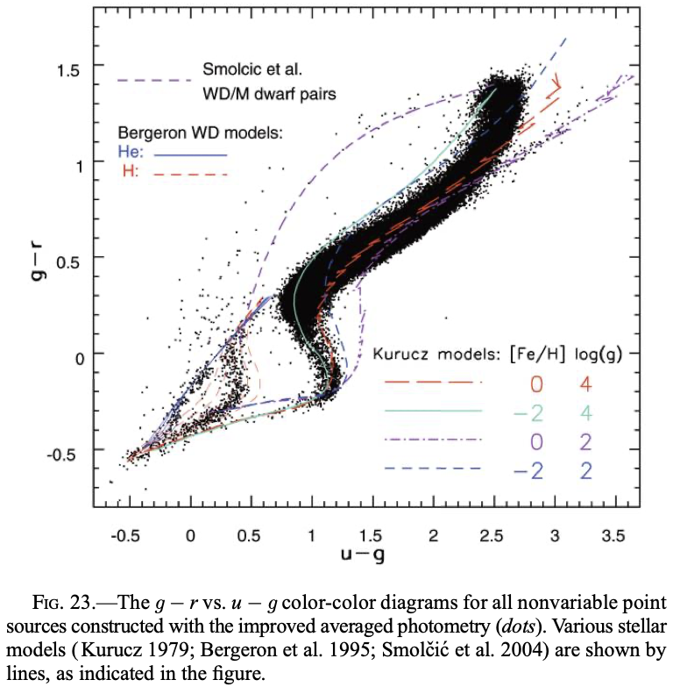
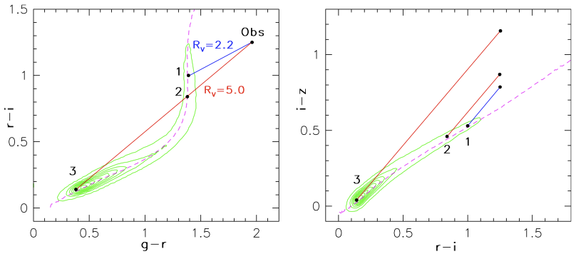
photo-D methodology: stellar astrophysics
SDSS color-color diagram (corrected for dust):
- stellar SEDs determined by: T_{eff}, [Fe/H], log(g)
- different populations: MS, giants, WDs, binaries
- assuming pop: from colors get best-fit SED
- best-fit SED gives Luminosity constraint
- pop probability can be gauged from goodness
of fit, variability, priors, and other info (WISE?)
- but there is dust:
Berry+ (2012, ApJ, 757, 166)

Slide 5
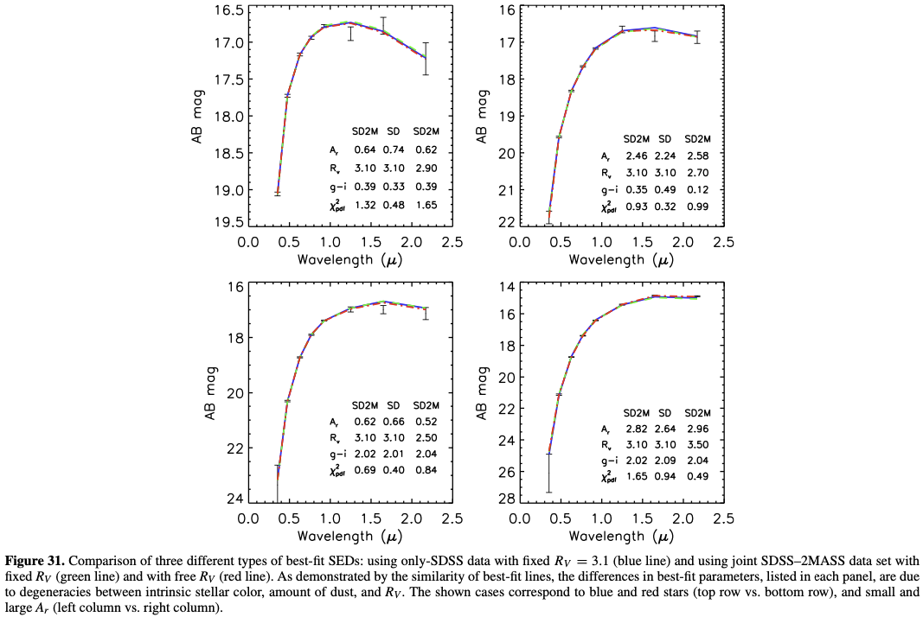
photo-D methodology: impact of dust
There are degeneracies with dust:
- need to adopt an extinction curve
- RV fixed or not?
Two fitting philosophies:
1) use stellar models to fit SEDs, or
2) use high-latitude observations to fit
dust-extincted low-latitude data
The role of priors...
Hierarchical Bayes (megaBEAST)?
We need a lot of testing!

Slide 6
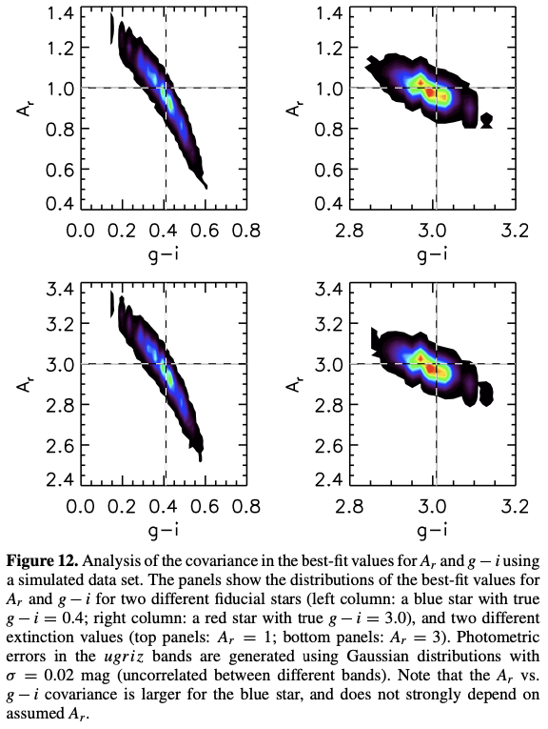
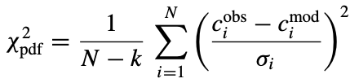
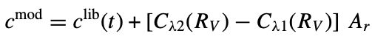
photo-D methodology: statistical treatment
Berry+ (2012): Fit SEDs constructed from high-b observations and a dust model parametrized by R_{V} (shape vs. wavelength) and Av (how much dust)
Compute best-fit via a brute force χ²-minimization process:
c_{i} and σ_{i} are N adjacent colors and errors (e.g., u - g, g - r, etc
the number of fitting parameters is k = 2 (the position along the locus
and A_{r}) for fixed-R_{V} (R_{V}=3.1), and k = 3 for free-R_{V}
model colors are constructed by:

Slide 7
photo-D methodology: needed improvements
Use of robust SED fitter? e.g. BEAST (https://beast.readthedocs.io/)
- many pros and cons here... or empirical isochrones?
Use of priors for stellar populations, as a function of (l,b) and magnitude
- can rely on TRILEGAL models that are available from NOIRLab’s DataLab, see
https://arxiv.org/abs/2208.00829v1
For a fixed (assumed population), use of priors for fitted parameters
- distances must be consistent with Gaia results
Automated quality assurance using Gaia data products (Bailer-Jones+ distances)
- if we design plans well, ample opportunities to engage students
Better code and documentation management
What we want to do is nicely described in Green et al. 2014 (ApJ, 783:114)

Slide 8
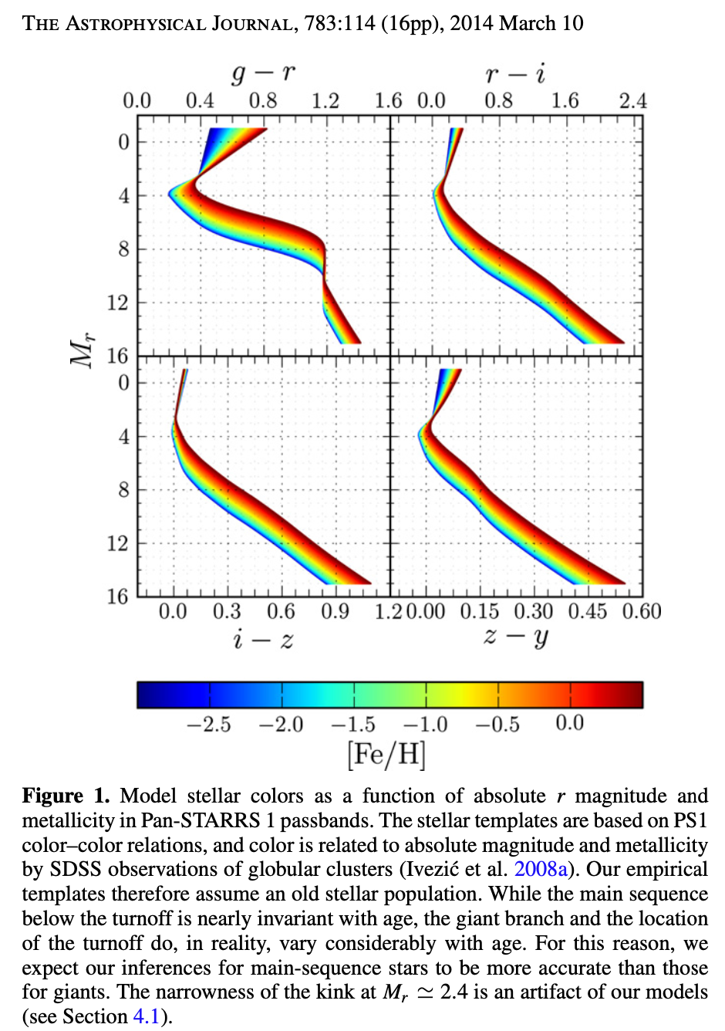
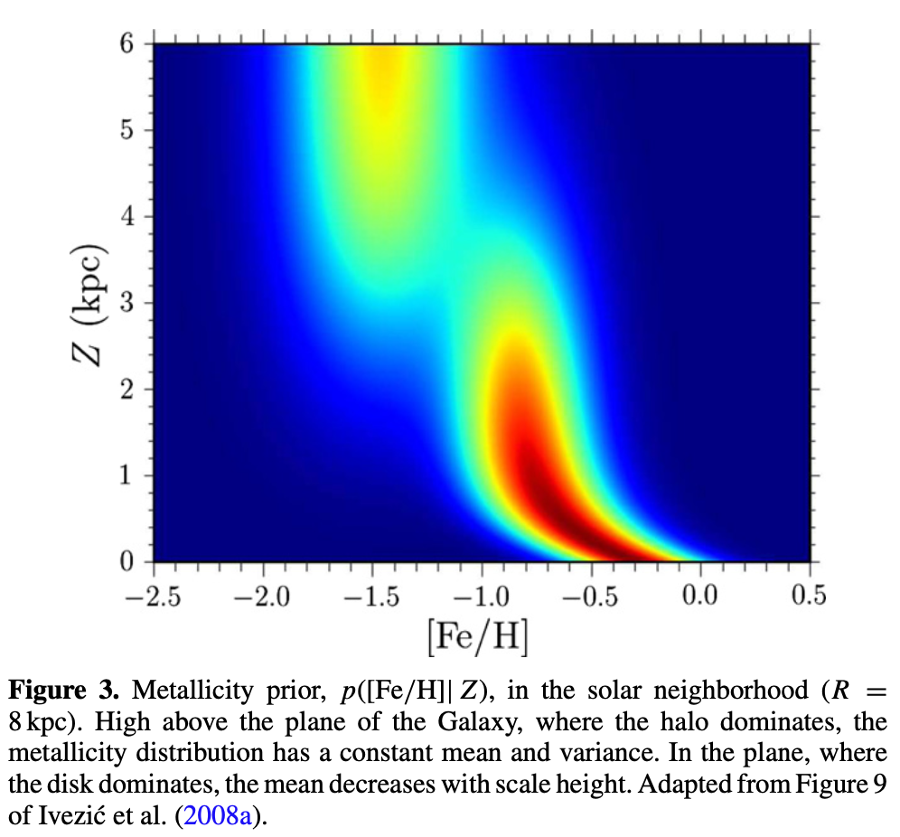
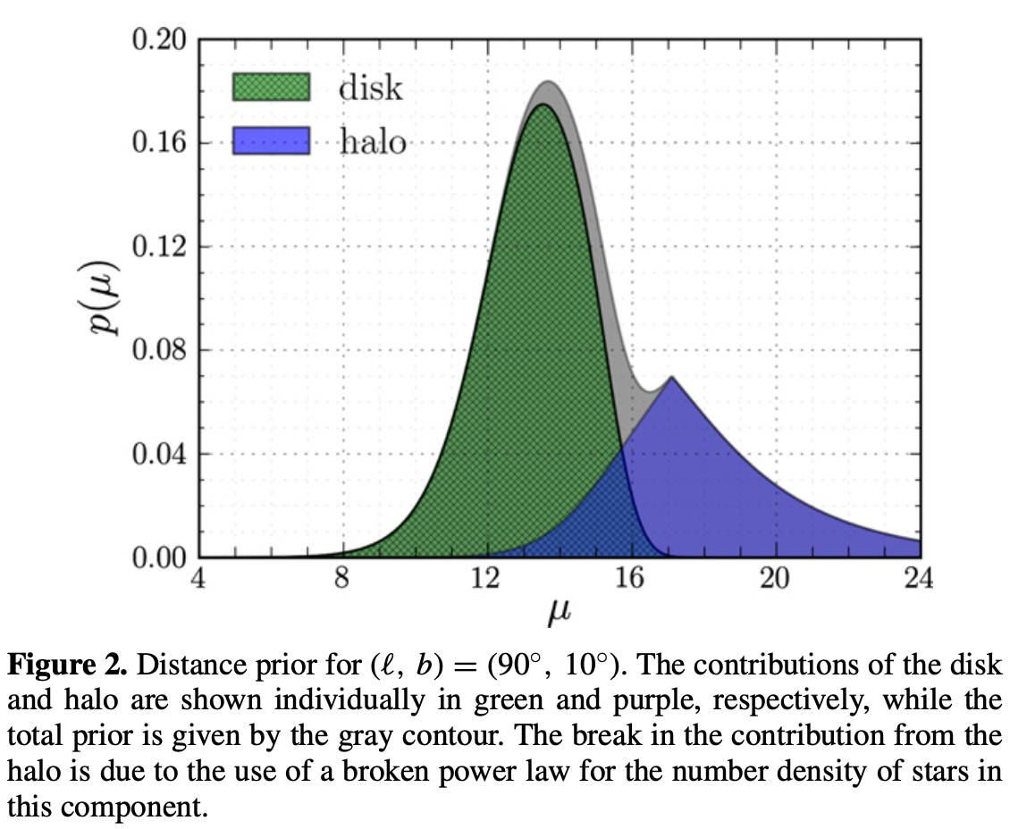
photo-D in Green et al. (2014)
Left: empirical isochrones
Middle: [Fe/H] prior as a function of distance from the Galactic plane (Z)
Right: distance prior

Slide 9
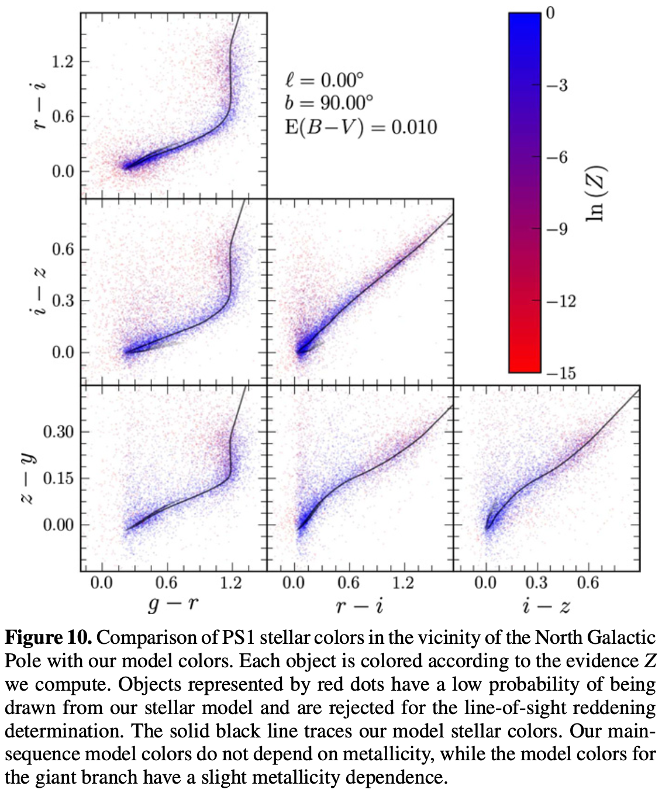
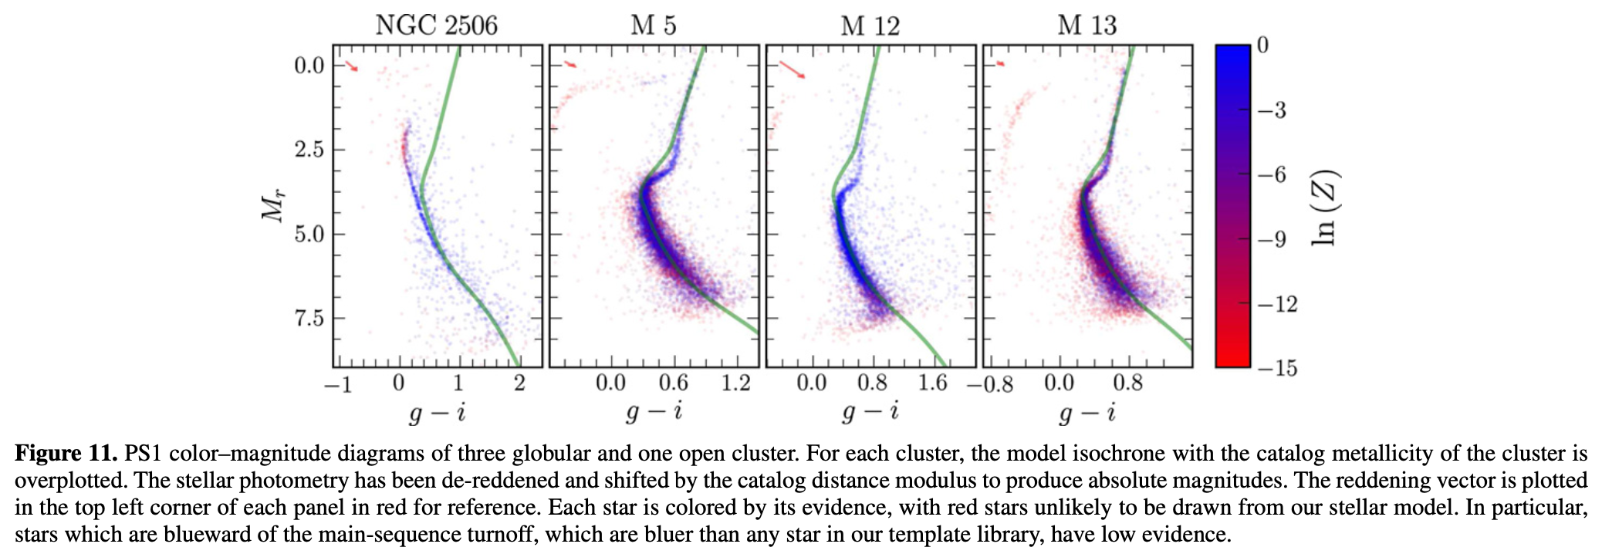
photo-D in Green et al. (2014)
Left: test of isochrones in PS1 color-color diagrams
Below: test using PS1 data for globular clusters

Slide 10
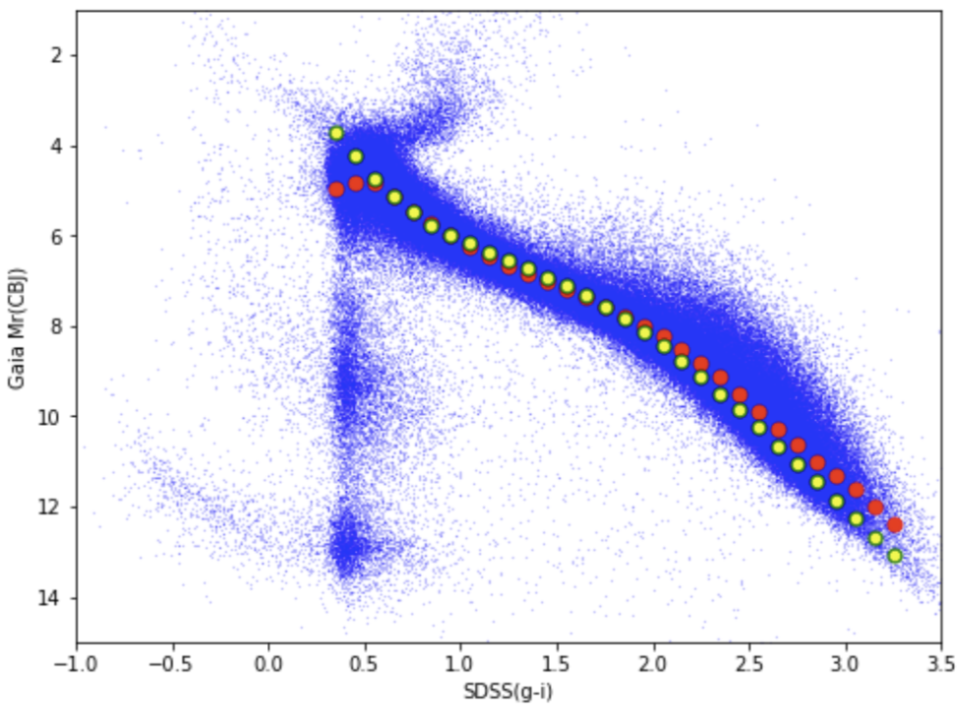
Comparison: Bailer-Jones+ distances from Gaia
Method paper and also the latest results: https://arxiv.org/pdf/2012.05220.pdf
Combines parallax measurement at the bright end and color-based distances
Somewhat similar to what we want to do with LSST data (1 colors vs. 5 colors...)
Their code is R, unclear if they plan to do anything with LSST data...
left: Gaia-SDSS sample from SDSS Stripe 82
blue: individual stars
X axis: g-i color measured by SDSS
Y axis: Mr from Bailer-Jones distances
red symbols: median Mr in g-i bins
yellow symbols: photo-D relation from SDSS Tomography papers (some mean [Fe/H])

Slide 11
Long-term plans, short-term plans...
plans for the next 12 months (approximately to ComCam first light)
- team responsibilities and (self)management
- overall timelines for project “WBS”
- collaboration & reporting tools
- coarse plans for the following 12+12 months
Phase 1: now to ComCam first light (Sep ‘22 to Aug ‘23)
Phase 2: commissioning + early ops (Sep ‘23 to Aug ‘24)
Phase 3: early ops and towards DR1 (Sep ‘24 to Aug ‘25)
first papers to write?
- reproducing Gaia distances with SDSS Stripe 82 photometry and BEAST etc.
- reproducing distances in TRILEGAL mock catalogs with chosen method

Slide 12
BACKUP SLIDES

Slide 13
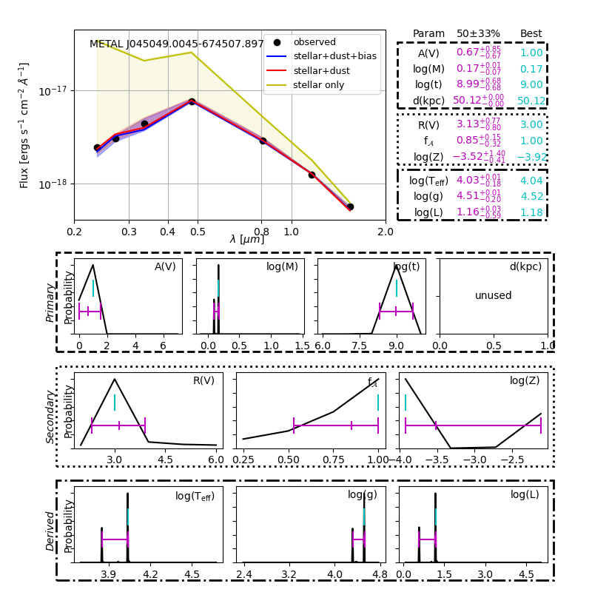
BEAST (Bayesian Extinction and Stellar Tool)
Gordon et al. paper about the BEAST code:
https://iopscience.iop.org/article/10.3847/0004-637X/826/2/104/pdf
Uses stellar models to fit SEDs and dust
Parametrized dust extinction curve
Fully Bayesian
Outputs posterior pdf-s for all parameters
Pro: public code, good open-source team
Con: - are stellar models good enough?
- is the code fast enough?
- is it easy to add features?
Presentation by Filip Matkovic at 10am

Slide 14
Testing plans
Can BEAST stellar models fit SDSS stellar locus?
Can BEAST reproduce distances in simulated Trilegal catalogs?
Can BEAST reproduce Bailer-Jones distances using SDSS data for Stripe 82?
Is the BEAST code fast enough? How long for 10 billion stars (say, on 100 cores)?

Slide 15
Computational Implementation
Scaling it up to 10 billion stars:
- do we want to parametrize stellar locus with the BEAST?
precompute LSST colors for the entire SED library (times dust...)
- should we utilize the fact that most stars are in the (narrow) locus?
IF in-locus DO hash-table ELSE call BEAST
- do we need other computational tricks?
HPC or cloud?
Only Croatian compute resources?
How much new code do we need to write?
Data model for BEAST outputs
How to get to LSST photometry (during commissioning and for DR1)?
How to federate outputs in Rubin Science Platform?

Slide 16
Collaborative Proposals?
Countries: Croatia, Hungary, Italy, Serbia, Slovenia - The CHISS Collaboration
Star Wars reference: The Chiss were a blue-skinned, near-human sentient species
that possessed red eyes and dark blue hair. They hailed from the planet Csilla.
Hungarian reference: Csilla is a Hungarian feminine given name that comes
from the Hungarian word csillag, literally meaning star!

Slide 17
Collaborative Proposals?
The (potential) concrete principal (but not exclusive) science deliverables
(desideratum: each country co-leads at least one theme)
1) Distance catalog with 20 billion LSST stars
Cro & Italy lead, using everyone's compute resources
Leads: Palaversa and Girardi?
Competitive advantages: experience with SDSS, a dedicated postdoc already
hired, available compute resources

Slide 18
Collaborative Proposals?
2) Classification and morphological characterization of active asteroids and comets
Hungary lead, with expertise from Serbia (?)
Leads: Szabo Gy. and ? (Mario Juric if we want to involve US)
Competitive advantages: expertise with extant data

Slide 19
Collaborative Proposals?
3) Expert AI/ML tool for distinguishing alerts coming from TDEs from those
due to Sne and other transients
Slovenia and Serbia co-lead
Leads: Gomboc and ?
Competitive advantages: experience with alerts, models for TDEs

